Slide 1


Retail Sales & Profitability Analysis
Data-driven business intelligence project delivering actionable insights for retail managers and analysts.
Shivam Singh — Python | SQL | Power BI

Slide 2

Business Problem
Thousands of daily transactions, limited clarity on profit drivers
Unclear impact of discounts on margins
Underperforming regions and loss-making products go unnoticed
Difficulty identifying high-value customers for targeted actions

Slide 3




Project Objective
Sales Analysis
Revenue trends and KPIs
Analyze overall sales and profit performance
Identify profit-driving categories and loss-making SKUs
Evaluate regional trends and discount effects
Deliver an interactive dashboard for decision-makers
Profit Focus
Category & SKU margins
Regional Insights
Underperforming areas
Discount Impact
Margin sensitivity

Slide 4

Tools & Workflow
Data Cleaning
Business Queries
Visualization
KPI Calculation
This end-to-end workflow ensures clean inputs, repeatable queries, visual storytelling, and measurable KPIs for fast decision-making.

Slide 5
Dataset Overview
9,994
21
Transactions
Columns
Individual sales records audited and cleaned
Sales, Profit, Discount, Region, Category, Customer, Shipping, and more
Data was cleaned, deduplicated, and transformed for reliable analytics and dashboard refreshes.

Slide 6

SQL Analysis Highlights
15+ business questions answered via parameterized queries
Revenue, profit, and margin by category/sub-category
Identification of loss-making SKUs and discount sensitivity
Top customers and transactional patterns for segmentation
Analysis logic is documented and reproducible for future queries.

Slide 7
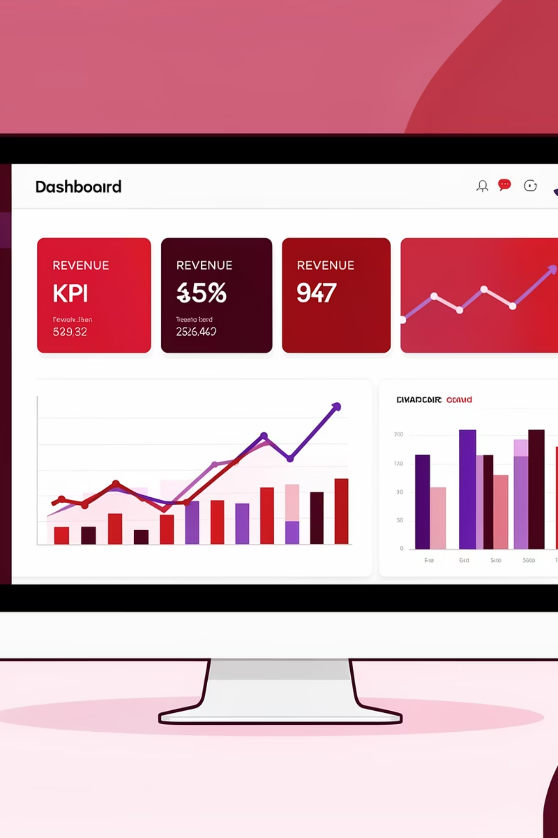
Dashboard Overview — Page 1
Executive overview containing Revenue KPI, Profit KPI, Order Count, Profit Margin, Sales Trend, and category/region performance snapshot.
High-level performance summary for management.

Slide 8
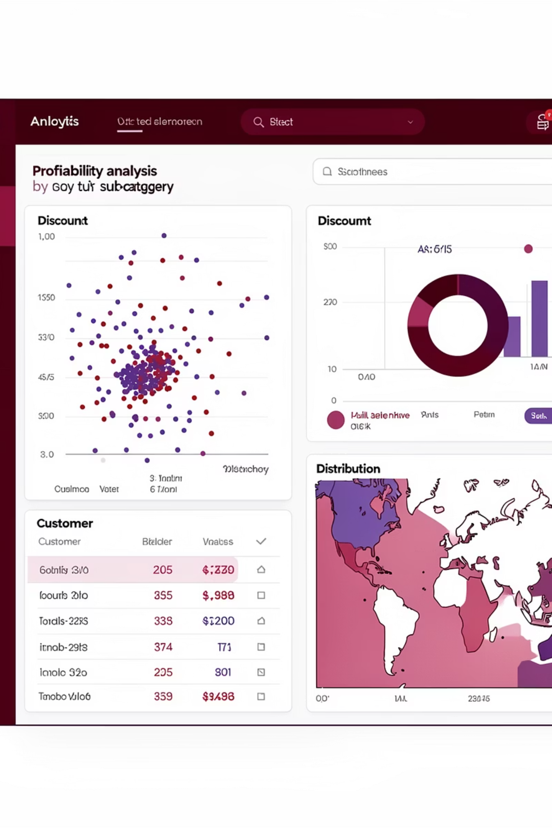
Profitability Deep Dive — Page 2
Focused views for sub-category margins, discount vs. profit analysis, top customers, loss-making products, and regional distribution for operational action.

Slide 9
Key Insights
Technology Leads Revenue
Discounts Compress Margins
Highest revenue concentration in tech categories; focus on inventory and upsell.
High-discount SKUs show materially lower profit margins — adjust promotion rules.
Concentrated Customers
Regional Variance
Revenue skewed toward a small cohort — prioritize retention and premium offers.
Some regions underperform despite strong SKUs elsewhere — examine pricing and assortment.

Slide 10

Project Impact
Next Steps
Clear, repeatable analytics pipeline enabling faster decisions and measurable margin improvements.
Implement prioritized recommendations and monitor via dashboard KPIs.
Recommendations
Optimize discount strategy: targeted, threshold-based promotions to protect margins
Drive assortment toward high-margin products and reduce loss-making SKUs
Deploy region-specific tactics: tailored pricing, inventory, and marketing
Strengthen retention programs for top customers to stabilize revenue
These steps will improve profitability while preserving competitive pricing.

